Slide 1
Topics in Physics
Course: LS2420-01(fufills natural science requirement)
Professor: Ricardo Rademacher
Email: Ricardor@physics.uc.edu

Slide 2
INTRODUCTION
The purpose of this class is to introduce to you various different topics in the field of physics. I wish to expose you, as artists, to the Worldview that we physicists have and hopefully inspire you to look at Nature using both your Creative and Causal minds. The course outline is flexible for the most part, though I will ensure that we cover all the major areas of physics. The first section is a Historical and Personal account of physics. Here we see physics develop through the ages and we see the people that were behind these discoveries. We then delve deeper into the different areas of physics.
Ultimately, Physics is a global representation of our world. It is the sum total of the all the observations that we can repeat. It represents a common language, but it is not truth, nor is it infallible. Through the ages, we see physics more fully representing the finer details of our natural reality, and thus changing.
I think that Art is similar or at least dual to Physics. Where Physics represents the world’s view, one shared by many people, Art is more of a personal view, shared by few or even just one. Yet they are both representations; they both describe something that the Artist or Physicist sees, feels, or intuits.
I am excited to see the blending of the Global nature of Physics with the Personal (Local) nature of Art and to see what comes of it.

Slide 3
Conceptual Outline (by no means an exhaustive list)
Basic math
Kinetic and Potential Energy
Conservation Laws
Forces and acceleration
Light, Sound, and other waves (not included)
Symmetries (not included)
Space and Time
Stars, Planets, and Cosmology (not included)

Slide 4
Broad Classification of Physics
Classical Physics: Newtonian Mechanics, Electro-Magnetism, Thermodynamics
Modern Physics: Relativity, Quantum Mechanics
Contemporary Physics: Cosmology, Grand Unified Theories

Slide 5
Class Logistics
Grading is based on Attendance, Assignments, and Assessments
Attendance: 20% or more classes missed:
AUTOMATIC FAILURE
Assignments: To be worked out, but most likely short essays,
small assignments, etc
Assessments: One Midterm and One Final
If any of you have known Learning Disabilities, please let me know ASAP. If you suspect that you may have a Learning Disability (Dyslexia, ADD, etc), please let me or Cathy Weimer know ASAP

Slide 6
PHYSICS THROUGH THE AGES
Aristotle 384-322 BC
Galileo Galilei 1564-1642 AD
Isaac Newton 1642-1726
Michael Faraday 1791-1867
Lord Kelvin 1824-1907
Albert Einstein 1879-1955
W. Heisenberg 1901-1976
Stephan Hawking 1942-
John Schwarz ??

Slide 7
We and our ancestors before us have all questioned the universe and their place in it. There have been many answers through the ages which inevitably lead to more questions in an endless vicious cycle. We shall briefly go through time and stop every so often to take a peak at the people of the time
Long seeking answers, the human psyche has found answer in the belief of greater powers at work in our destiny and thus place their faith in gods. So by the time we arrive at Grecian times, the answers lay in the various gods and myths that inhabited the land. The gods controlled the wind, lightning, oceans and the destinies of all on Earth. Aristotle was to organize and categorize phenomena and objects. He introduced rational, logical thought and thus created a belief in ourselves He detached a certain order from the nature of things and thus begins physics, with the belief the man can organize, classify and understand his world
We next take a big leap forward, roughly 18 centuries. Here we meet a curious fellow by the name of Galileo Galie of Italy. He has taken it upon himself to prove and disprove certain ideas. Some of these ideas, people would say, are sheer madness. But unlike his other contemporaries there was a method to his madness. By careful observation and measurement and by repeating his experiments many times over, he established relationships in our physical realm. He was the first to set out and prove that two objects of dissimilar mass will fall at the same rate. He is credited with inventing the telescope. His bold statements (bold for the time!) where not met with much enthusiasm from the Roman Catholic church, nor by the followers of Aristotle, who’s teachings still held true 18 centuries later. For his unyielding commitment to what his experiments (and not the church or Aristotle) said about the world, he was to remain imprisoned from (?) time the time of his death in (?). In the 1990’s , the Pope John Paul officially reversed and pardons Galileo and admitted the Roman Catholic church committed a mistake in keeping him under house arrest till his death

Slide 8
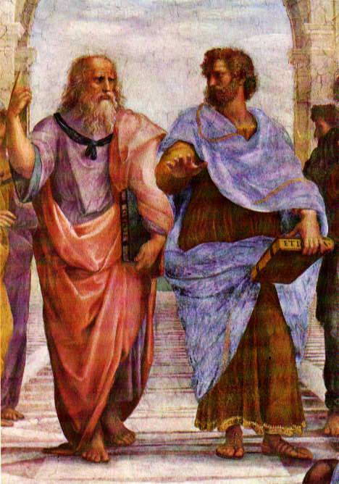
Aristotle
the father of modern science organized science in reasoned ways
Plato's students ; Alexander’s teacher
Deconstructionalist: believed that any question could be successively broken down into fundamental parts
wrote physics and seminal work in logic. His physics was theological in nature it contained the four elements earth, wind, water, and fire
and the four causes:
causes of matter and form ,the moving cause, final cause and potential
his ideas held up all the way to Galileo's time

Slide 9
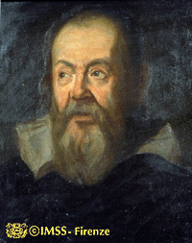
Galileo
first to use experiments and mathematics to prove or disapprove ideas
things of different masses fall at the same rate and the distance interval increases as the square of time
Telescope and Microscopes
Isochronicity: equal times at each swing of the pendulum
physical experiments merely approach ideas; his word for experiments “cimento” ordeal

Slide 10
INTRODUCTION TO MEASUREMENTS, UNITS, NUMBERS, AND OTHER HORRIBLY BORING STUFF
If we wish to do Physics, we need to establish standards to measurements. Using standard units for measurements, scientist can converse about their results to any other scientist around the world. A measurement is any action that I take as observer to obtain properties of the observed.
Another core element of the science is REPEATABILITY. This means that if a scientist gets a result in Japan, I should be able to reproduce it here in the US using his same techniques and equipment. This is why Parapsychology (the study or paranormal phenomena) is not strictly science, since we can never repeat results concerning ghosts, spontaneous combustion, etc.
As such, we need to establish standards for measurements. There are two main standards. The SI standard is almost exclusively used for science, while the British system is used here in the US for all other endeavors.

Slide 11
The (European) standard for physics is the Standard Internationale (SI) system, developed by the French.
In this system:
Distance: the meter
Time: the second
Mass : the kilo
In the U.S.A., we use the British System. In this system:
Distance: the foot
Time : the second
Weight: the pound
(Notice that the SI system measure mass, while the British systems uses weight (which is
the effect of gravity on mass) )

Slide 12
Distance
the space between two points
Establishes a relationship between two points
Symbols : x, x₁, x₂
Position 1
Position 2
Position 3

Slide 13
Velocity
Velocity has magnitude (it’s speed) and direction
Symbols: v, v₁, v₂
Velocity 1
Velocity 2
Position 1
Time 1
Position 2
Time 2
Position 3
Time 3

Slide 14
Acceleration
Also has a magnitude and direction
Symbols: a, a₁,a₂
Acceleration
Velocity 1
Velocity 2
Position 1
Time 1
Position 2
Time 2
Position 3
Time 3

Slide 15
NEWTONIAN MECHANICS
It is with a sense of continuity that upon the year of Galileo's death, a premature, frail, and sickly Isaac is born to (?) and (?) Newton. Not expected to live long, he defeats the odds and grows up to become the cornerstone of the great enterprise of Physics. His three laws of motion describe with great accuracy all of the motion that people knew of in that age. This included Earth bound motion as well as the movement of the celestial objects.
Newton was the first to define a contact force and force at a distance. A contact force is like a push or pull, motion due to the direct physical contact of two objects. Force at a distance is motion due to an object that is not in physical contact. Gravity is the first example of the later. Newton was the first to state that our falling to the Earth and the planets motion are related by gravitational attraction
Because Newton's Laws (as well as his other observations) seem so universal, it was easy for people of the time to believe in the ultimate truth behind Newtonian physics. He directly set the stage for the industrial revolution and Victorian England. It wasn’t until the turn of the century that Newtonian mechanics was successfully challenged (this is due to the advent of Relativity and Quantum Mechanics; more on this later)

Slide 16
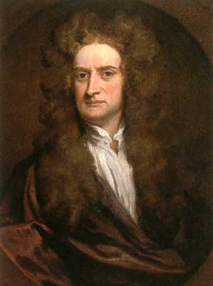
Newton
Laws of motions, Gravitation, Calculus, and theory of optics. Collectively known as Newtonian Mechanics.
1687 publishes The Principia
introduced his three laws of motion
an object in motion or rest remains at motion or rest unless acted upon by an external forces
acceleration of a body is proportional to the forces acting on it and inversely proportional to the mass (F=ma)
for every action there is an equal and opposite reaction (momentum conservation)

Slide 17
Newton and the Laws
#1 A mass in motion (or rest) continues at motion (or rest) unless acted upon by a net force.
Defines mass and inertia.
Acceleration
FORCE
M
M
M
M
Velocity
M
M
Position 1
Time 1
Position 1
Time 3
Position 1
Time 2
Position 1
Time 1
Position 2
Time 2
Position 3
Time 3

Slide 18
Newton and the laws
#1 A mass in motion (or rest) continues at motion (or rest) unless acted upon by a net force.
Defines mass and inertia.
Acceleration
=
Velocity 1
Velocity 2
M
FORCE
M
M
Position 1
Time 0
Position 2
Time 1
Position 3
Time 3

Slide 19
#2 Force equal Mass times Acceleration
FORCE
=
M
X
Acceleration
F=M a
NEWTON: Unit of force= mass (kg) times acceleration (m/s²)
1 N =

Slide 20
#3 For every action there is an equal and opposite reaction
WEIGHT
WEIGHT
Example of a Force
Pair
FORCE
FORCE

Slide 21
#3 For every action there is an equal and opposite reaction
FORCE
VELOCITY
Example without Force
Pair
VELOCITY
WEIGHT

Slide 22
Introducing Momentum
Momentum equals mass times velocity
p=mv
Formally, momentum reflects how energy changes with time
p=
M
Velocity
Velocity
Before Collision
M
Velocity
M
Velocity
After Collision
M

Slide 23
Billiards as a model of the Universe
In Newton’s world, the universe could be understood as a gigantic Billiards game. After all, using his law’s we should be able to perfectly predict how one ball interacts with all the others. Put another way, Newton’s Laws make a billiards game perfectly predictable; since we can always determine where the balls will be at any time, Newton’s laws are a Deterministic theory.
M
M
M
M
M
M
M
M
M
M
M

Slide 24
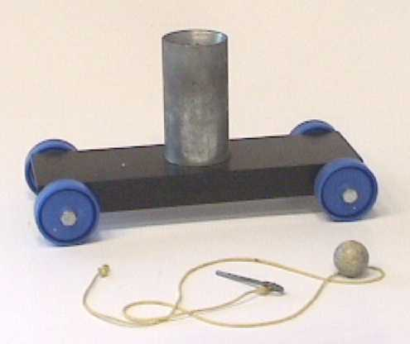
DEMO: Cart and ball
Demonstration of Newton's first law
Shows that forces in the x-dir are independent of forces in the y-dir. In other words, the cart and balls velocity will always be the same in the x direction irrespective of the balls y velocity
y
x

Slide 25
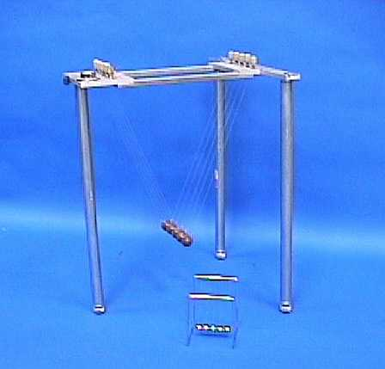

DEMO:Newton’s Cradle
Conservation of Momentum and Energy
When we raise any number of balls, the amount of Momentum and Energy must remain the same at all times; hence if we raise one ball, one ball must be in motion at all times

Slide 26
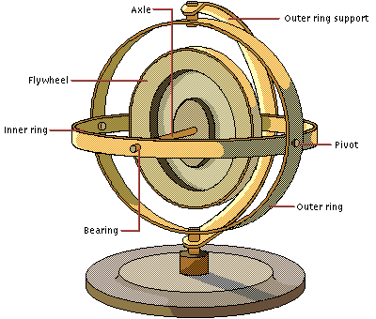
DEMO: Gyroscopes
Newton's laws in two dimensions (rotating)
Shows that Newton's laws are valid irrespective of the type of motion (straight or curved)
This gyroscope is designed so that the flywheel and axle are free to point in any direction. Gyroscopes are useful in navigation because they are "rigid in space; a spinning gyroscope mounted within a vehicle always points in the same direction. Thus a gyroscope provides a means to determine a vehicle's orientation, without relying on visual cues that may not always be available (in fog or at night, for example).
Photo and Text: Microsoft Encarta ©

Slide 27
Homework One
Due Monday February 5
1) Describe, Draw, or explain 3 applications of:
i) Newtonian Mechanics
ii) ElectroMagnetism
iii) ThermoDynamics
2) Describe, Draw, or explain 1 application of
Quantum Mechanics or Relativity
Which theory seems the most interesting
so far? Which style of presentation?
If none, please elaborate on what you don’t like and why :)

Slide 28
THERMODYNAMICS
Thermodynamics covers a wide variety of phenomena. It is the fundamentally the theory of heat
And since heat is a form of energy, Thermo is also a theory of energy. Here, we study the how
Heat flows from on material to another and how the material responds to this change in heat.
Like in Newtonian Mechanics, there are three (plus one) laws that form the basis of our understanding of heat and thermodynamics. These three laws define the direction of heat flow, conservation of heat energy, and the minimum temperature a body can achieve
With the insight of Lord Kelvin, we came to understand heat as the random motion of molecules
Within a body. Therefore, a cold objects molecules are moving less energetically than a hot.
This is the Kinetic Theory of Thermodynamics and let’s us understand that heat is nothing more
Than a measurement of the average energy that a molecule has in a system.
Thermodynamics main application when it was first postulated was in the theory of heat engines. At that time, water power was the main source of energy for human projects. Thanks to the understanding brought forth by thermo, the Heat Engine becomes possible. Hence, the steam and later the petroleum engine redesigned the human landscape by making large distances seem small thanks to trains and large jobs seem easy thanks to powerful heat engines.

Slide 29
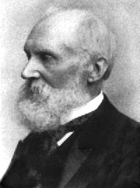
Lord Kelvin
Son of a Mathematician, did fundamental work on the theory of Heat. Made possible the Kinetic theory of Matter
Absolute Temperature scale; 2nd law of Thermodynamics:
entropy can never decrease.
Joule-Thompson effect: temperature decrease upon expansion into a vacuum.
Published 600 papers, has 70 patents, and is buried near Newton in Westminster Abbey

Slide 30
Energy!
Technically, Energy is a concept on the ability to do
work; anything that moves or has the potential to move has energy. Energy comes in many guises:
Mechanical Energy
Electromagnetic Energy
Heat Energy

Slide 31
Mechanical Energy
This is the energy associated with both static and moving matter
Potential energy: Static energy
Kinetic energy: Moving energy
Work energy: Forced energy
Anything with mass that has the potential to move has potential energy:
For example,a mass (m) in Earth’s gravitational field (g) has gravitational potential energy
PE_{G}=m x g x height
KE = ½ m v²
Anything that has mass and is in motion has kinetic energy
W= F x d
Work is done when a force is applied over a distance.

Slide 32
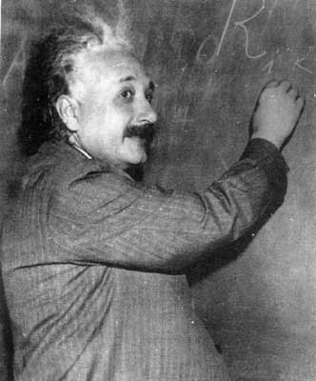
Einstein
German, Jewish, violinist, pacifist, physicist
Best known for his work on Relativity. Gave us notions of Space-Time and that everything is relative
1905: publishes three papers
Photoelectric effect: one of the first hints of quantum phenomena
Brownian Motion: statistical mechanics
Special Relativity: E=MC²
1915 General Relativity
1921 Nobel Prize for photoelectric effect

Slide 33
Newton's Rigid Laws…..
In Newtonian times, Effect is preceded by Cause… an object is at rest or not. If not, an Effect must have Caused it to move.
Simultaneous events and the Laws of Physics are unchanged in any Inertial Reference Frame
Space and velocity were infinite, time was a convenient placeholder
An object was allowed to have any velocity

Slide 34
Einstein's Vision
Speed of light is const
Variables get distorted as velocity approaches c (time dilation, length contraction, mass increase)
Space and time are one: spacetime
Energy and Mass are one: E=m c²
Mass Affects the “fabric” of spacetime

Slide 35
Speed of light is constant and a limit!
Newtonian Physics: Inertial Frames of Reference: the universality of the laws of physics under constant velocities. Hence, changing coordinates are governed by Galilean Transformation: velocities add up
Einstein said the velocity of light never adds up to anything… it is always c. Hence, changing coordinates need a Lorentz Transformation such that the speed constancy and limit of c is imposed

Slide 36
REAL fast and REAL weird : approaching c
Gamma is a way to represent
how fast we are going
Half the speed of light (.5 c)
150 thousand m/s or 346 million mi/hr
Speed of light (c)
3 x 10⁶ m/s or 671 million mi/hr
At Rest (0 m/s)
.99 c
.9 c
=0
.8 c
=2.3
=1.7
=22
=1
=1.2
=
0
c

Slide 37
length contraction
L_{moving} = g⁻¹ L_{rest}
10 m
1
10m
10m
0
c

Slide 38
length contraction
L_{moving} = g⁻¹ L_{rest}
8.3m
.833
10m
10m
Velocity=.5 c
0
c

Slide 39
length contraction
L_{moving} = g⁻¹ L_{rest}
6 m
.6
10 m
10m
Velocity=.8 c
0
c

Slide 40
length contraction
L_{moving} = g⁻¹ L_{rest}
5.2 m
.52
10m
10m
Velocity=.9 c
0
c

Slide 41
length contraction
L_{moving} = g⁻¹ L_{rest}
45 cm
.045
10m
10m
Velocity =.999c
0
c

Slide 42
time dilation
t_{moving} = g t_{rest}
1 s
1
1 s
0
c

Slide 43
time dilation
t_{moving} = g t_{rest}
1.2 s
1.2
1s
0
c

Slide 44
time dilation
t_{moving} = g t_{rest}
2.3 s
2.3
1 s
0
c

Slide 45
time dilation
t_{moving} = g t_{rest}
22 s
22
1 s
0
c

Slide 46
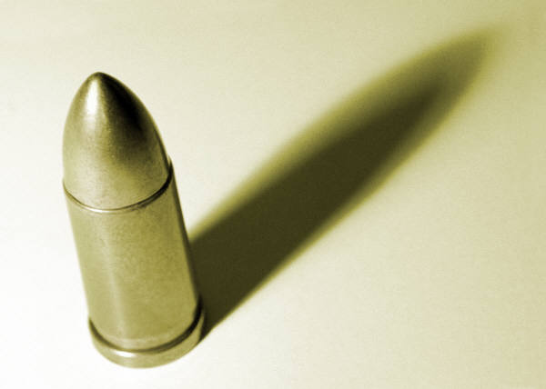
mass increase
M_{moving} = g M_{rest}
10g
1
10g
0
c

Slide 47
mass increase
M_{moving} = g M_{rest}
12g
1.2
10g
0
c

Slide 48
mass increase
M_{moving} = g M_{rest}
17g
1.7
10g
0
c

Slide 49
mass increase
M_{moving} = g M_{rest}
71g
7.1
10g
0
c

Slide 50
enter spacetime….
Einstein’s idea was that time was not just a number or variable, but just as dynamically significant as the three spatial dimension.
(x,y,z) → (t,x,y,z)
Replace z direction
with a time direction
z
t
x
x
x
y
y
y

Slide 51
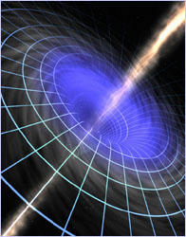
Mass and Spacetime
Einstein postulated that Mass affect Spacetime.
Mass will “Bend” the fabric of space time
If there is enough mass, a “rip” in the fabric of spacetime forms a black hole

